Slide 1
OVERtreatment due to biased evidence synthesis:
Brian S. Alper, MD, MSPH, FAAFP
Founder of DynaMed
Vice President of EBM Research & Development, Quality and Standards, EBSCO Health
THE CASE OF THROMBOLYSIS IN ACUTE STROKE
Notes:
This presentation was given October 29, 2015 in Taormina, Italy at the 7th International Conference for EBHC Teachers and Developers

Slide 2
COMPETING INTERESTS DISCLOSURES
Dr. Alper is an employee of EBSCO Health which publishes DynaMed
Dr. Alper has published an article in BMJ expressing the intellectual concepts in this presentation.
Notes:
Dr. Alper created DynaMed which systematically monitors clinical research results, critically appraises the evidence, objectively reports the findings, and synthesizes results for presentation for use by health care professionals at the point of care to rapidly find current reliable clinical decision support. DynaMed was not directly mentioned in the presentation but the work of DynaMed is how the content discussed was discovered. A potential intellectual competing interest is that Alper and colleagues published these concepts in BMJ 2015 Mar 17;350:h1075.

Slide 3
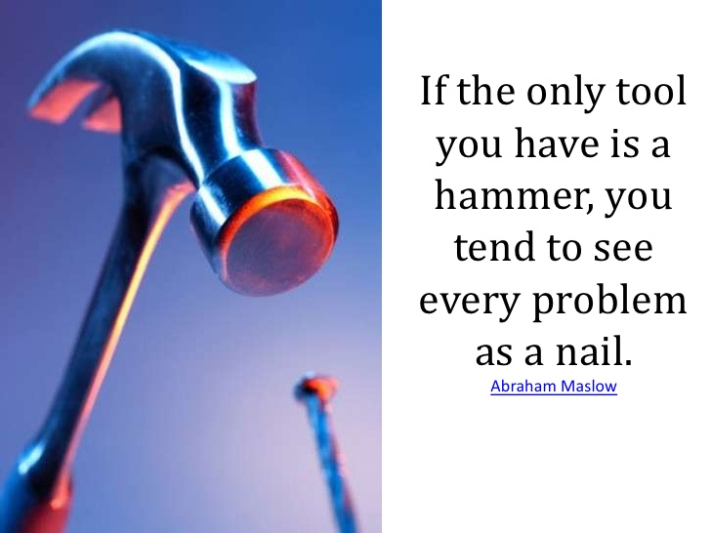
StrokE is common
and
Until recently, thrombolysis has been the only active therapy specifically for treating stroke
Notes:
Stroke is common and until recently (with evidence supporting efficacy of endovascular therapy) thrombolysis was the only therapy in the acute setting specifically expected to change the causative factors leading to stroke. If you only have one tool in your toolbox….

Slide 4
THE TRUTH
No or uncertain benefit
The evidence regarding use of thrombolysis, especially 3+ hours after stroke, is limited, inconsistent, and uncertain.
Notes:
The evidence for efficacy of thrombolytics 3-4.5 hours after stroke is limited and inconsistent, so our best estimate of efficacy is no overall effect with substantial uncertainty in our estimate.

Slide 5
THE TRUTH
No or uncertain benefit
1 in 44 have fatal bleeding
The evidence regarding use of thrombolysis, especially 3+ hours after stroke, is limited, inconsistent, and uncertain BUT the harm is established.
Notes:
BUT the evidence for harm is consistent. The most recent estimate for fatal intracranial hemorrhage is NNH 44.

Slide 6
THE TRUTH
No or uncertain benefit
1 in 44 have fatal bleeding
The evidence regarding use of thrombolysis, especially 3+ hours after stroke, is limited, inconsistent, and uncertain BUT the harm is established.
Notes:
Harms (certain) outweigh benefits (uncertain) for use of thrombolytics 3-4.5 hours after stroke.

Slide 7
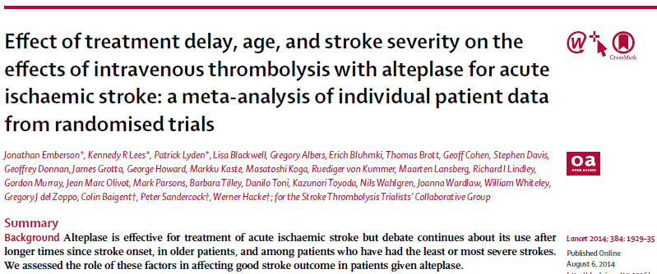
but
None of the sources where you’d expect to find the best objective answer were providing this view.
Notes:
BUT an individual patient data meta-analysis reports overall benefit up to 4.5 hours after stroke

Slide 8
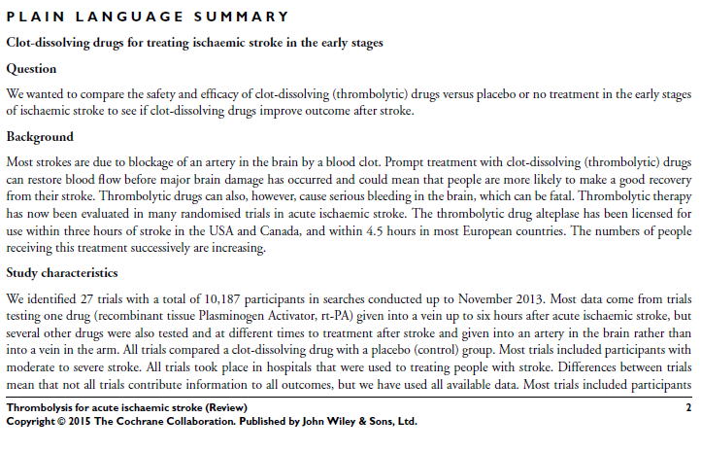
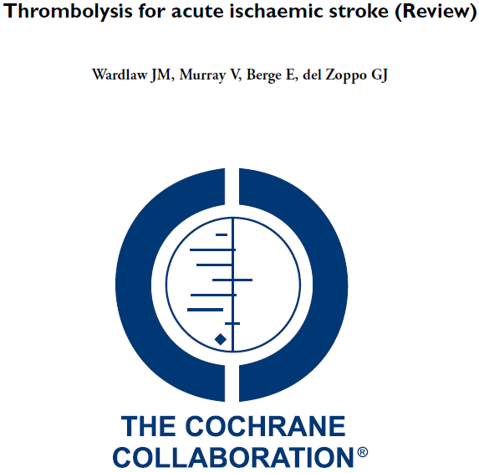
but
None of the sources where you’d expect to find the best objective answer were providing this view.
Notes:
BUT the Cochrane review reports definite benefit up to 4.5 hours after stroke

Slide 9
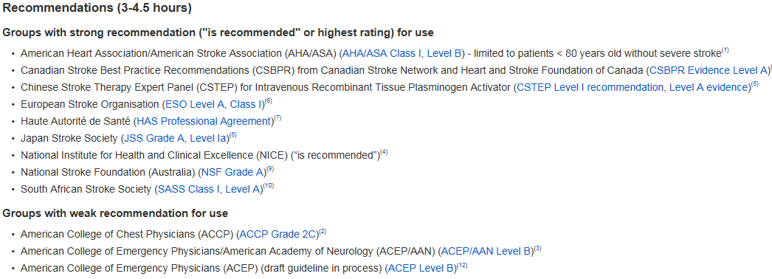
but
None of the sources where you’d expect to find the best objective answer were providing this view.
Notes:
Nearly all guidelines recommend thrombolytics 3-4.5 hours after stroke (The Canadian Association of Emergency Physicians [CAEP] is the one guideline recommending against this practice)

Slide 10
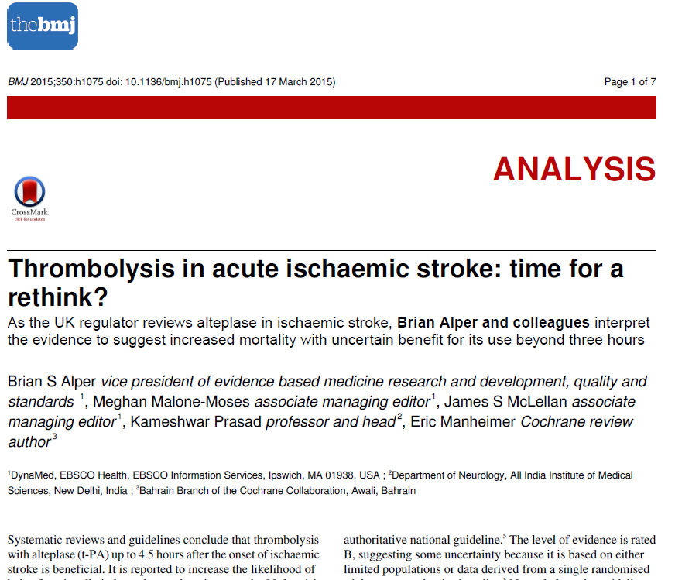
Therefore…
We reported it in BMJ
Notes:
We published this story in BMJ 2015 Mar 17;350:h1075.

Slide 11
How could this occur?
How can people trying to do the right thing go so wrong?
Notes:
Systematic reviewers and guideline developers are trying to help determine the most accurate information and improve care. Why are the results so different than the original data would suggest?

Slide 12
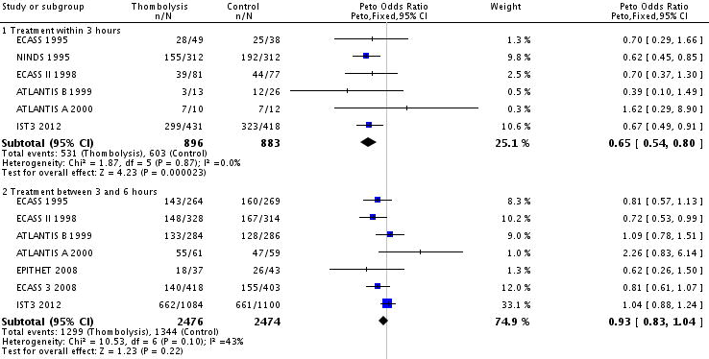
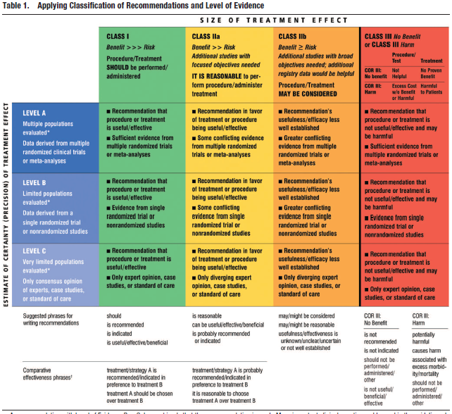
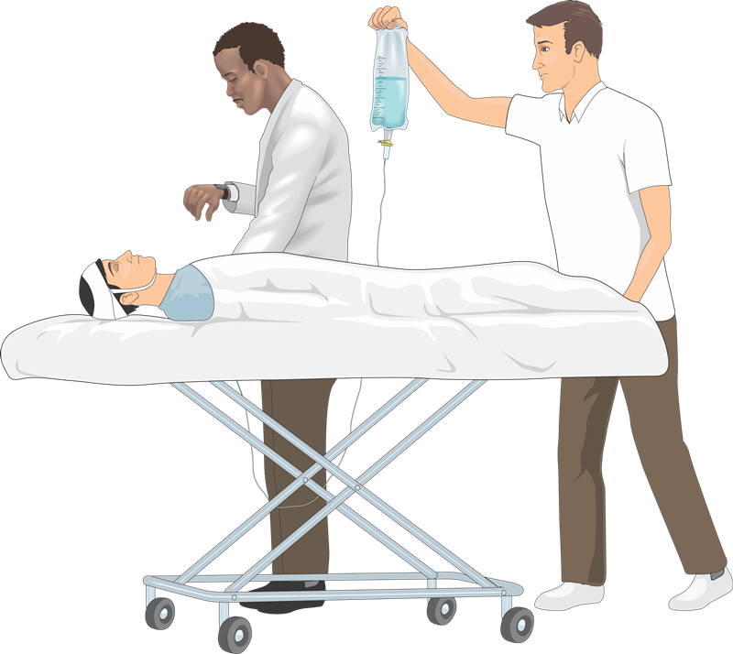
Evidence biased synthesis
Evidence production
Evidence based synthesis
guidelines
Clinical Practice
Evidence production
guidelines
Clinical Practice
Notes:
This slide is best presented in 3 stages: 1) show the top picture and explain the multiple steps from research to practice, 2) show the bottom picture and ask how the picture differ, 3) note the bias introduced dearly and how it could be difficult to see how it appears later on

Slide 13
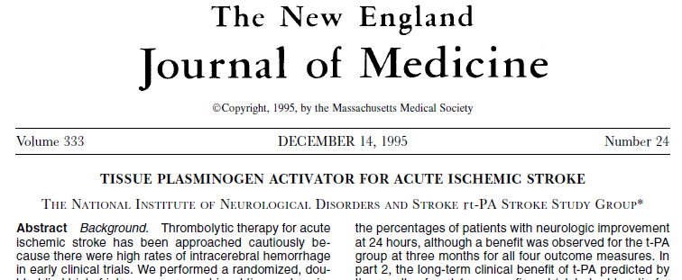
Ninds trial - 1995
624 patients
0-3 hours after stroke
NIHSS 0-1 at 90 days in 34% vs. 20.5% (NNT 8)
mRS 0-1 at 90 days in 42.5% vs. 26.5% (NNT 7)
fatal intracranial hemorrhage in 2.9% vs. 0.3% (NNH 38)
Notes:
The NINDS trial “established” efficacy for thrombolytics up to 3 hours after stroke (if you accept establishing such a thing based on one trial with potential baseline differences). Based on this trial guidelines and standard practice became use of thrombolytics up to 3 hours after stroke.

Slide 14
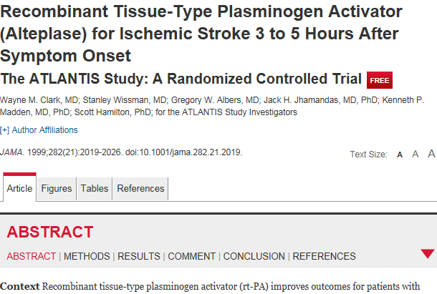
Atlantis trial - 1999
613 patients
3-5 hours after stroke
NIHSS 0-1 at 90 days in 33.8% vs. 32% (not significant)
fatal intracranial hemorrhage in 3% vs. 0.3% (NNH 37)
Notes:
In 1999 a well-done trial attempted to extend the use of thrombolytics beyond 3 hours, and found no benefit but increased harm.

Slide 15
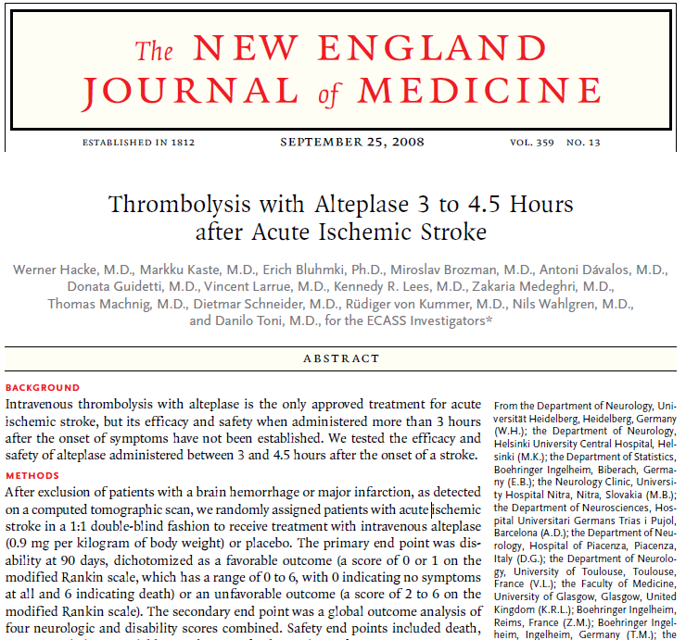
ECASS III - 2008
821 patients
3-4.5 hours after stroke
mRS 0-1 at 90 days in 52.4% vs. 45.2% (NNT 14)
symptomatic intracranial hemorrhage by NINDS definition in 7.9% vs. 3.5% (NNH 22)
fatal intracranial hemorrhage in 0.7% vs. 0% (not significant)
Notes:
In 2008 the ECASS III trial evaluated thrombolytics 3-4.5 hours after stroke and found benefit which appeared to outweigh the harm. Based on this one trial guidelines started in 2009 to set thrombolytics up to 4.5 hours after stroke as the standard of care in stroke management.

Slide 16
ECASS III - 2008
ATLANTIS - 1999
821 patients
3-4.5 hours after stroke
mRS 0-1 at 90 days in 52.4% vs. 45.2% (NNT 14)
symptomatic intracranial hemorrhage by NINDS definition in 7.9% vs. 3.5% (NNH 22)
fatal intracranial hemorrhage in 0.7% vs. 0% (not significant)
613 patients
3-5 hours after stroke
NIHSS 0-1 at 90 days in 33.8% vs. 32% (not significant)
fatal intracranial hemorrhage in 3% vs. 0.3% (NNH 37)
Notes:
But if you like at the body of evidence we had 2 major trials with inconsistent results – at best we have substantial inconsistency and uncertainty and we are not ready to recommend extending thrombolytic use after 3 hours.

Slide 17
ECASS III - 2008
821 patients
3-4.5 hours after stroke
mRS 0-1 at 90 days in 52.4% vs. 45.2% (NNT 14)
symptomatic intracranial hemorrhage by NINDS definition in 7.9% vs. 3.5% (NNH 22)
fatal intracranial hemorrhage in 0.7% vs. 0% (not significant)
Notes:
So it is important to go back to the ECASS III trial and conduct a critical appraisal of all the factors that may influence reliability of the results

Slide 18
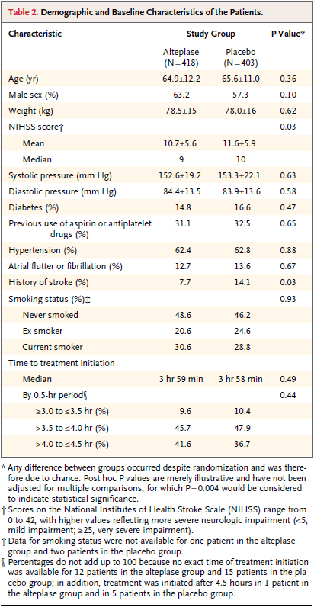
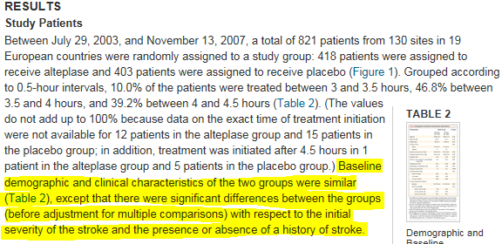
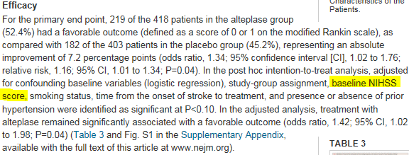
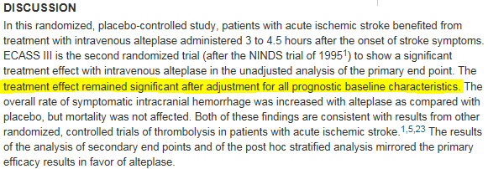
ECASS III – 2008
Notes:
The original trial report for ECASS III noted an imbalance at baseline in the history of prior stroke (occurring in 7.7% of the thrombolytic group and 14.1% of the placebo group). This imbalance was presented as not statistically significant and not influencing the primary efficacy analysis.

Slide 19
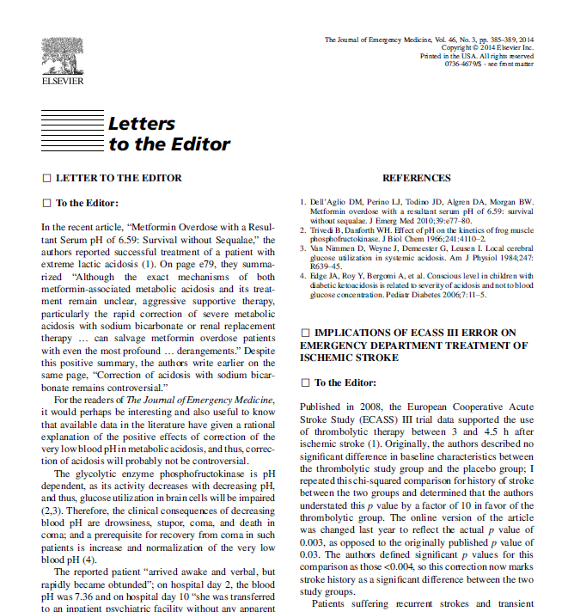
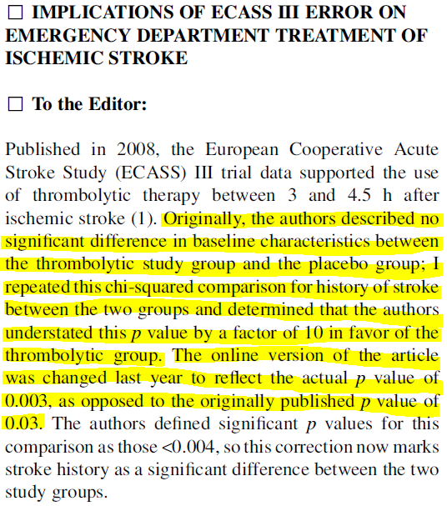
regarding
ECASS III – 2008
Notes:
In 2014 (6 years after the 2008 publication) the imbalance in history of stroke was reported to be statistically significant and the letter in a different journal noted “The online version of the article was changed last year to reflect the actual p value of 0.003, as opposed to the originally published p value of 0.03.”

Slide 20
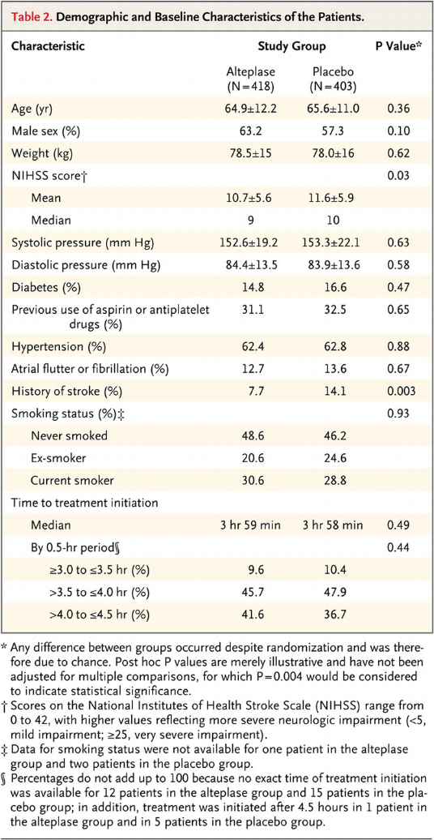
ECASS III – 2008
Notes:
Today the ECASS III trial finds Table 2 with the corrected p value BUT there was no change to the text of the article or re-analysis regarding the influence of this baseline difference on the overall results.

Slide 21
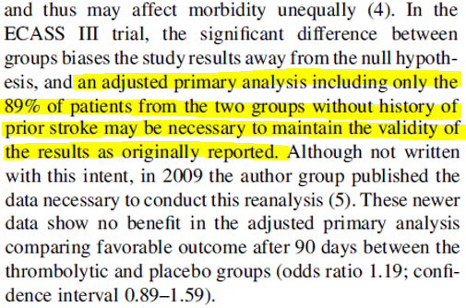
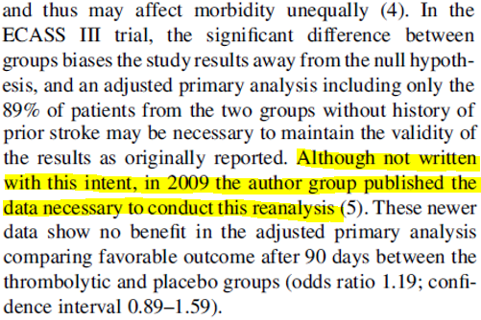
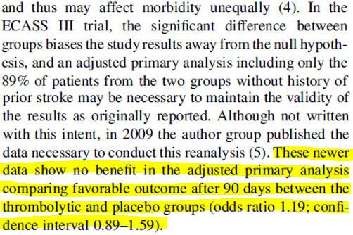
regarding
ECASS III – 2008
Notes:
A reanalysis done by others, limited to the 89% of patients in ECASS III without a history of prior stroke, found no significant difference in the primary outcome.

Slide 22
ECASS III - 2008
ATLANTIS - 1999
821 patients
3-4.5 hours after stroke
mRS 0-1 at 90 days in 52.4% vs. 45.2% (NNT 14)
symptomatic intracranial hemorrhage by NINDS definition in 7.9% vs. 3.5% (NNH 22)
fatal intracranial hemorrhage in 0.7% vs. 0% (not significant)
613 patients
3-5 hours after stroke
NIHSS 0-1 at 90 days in 33.8% vs. 32% (not significant)
fatal intracranial hemorrhage in 3% vs. 0.3% (NNH 37)
??? No longer a significant benefit if adjusted for baseline differences in history of prior stroke ???
Notes:
So we have 2 major trials with inconsistent results, and the trial finding benefit may not be supportive of benefit after adjustment for baseline differences.

Slide 23
NINDS, ATLANTIS, ECASS III
What if we could put all the trials together?
An individual patient data meta-analysis
In 2010…
Notes:
Could an individual patient data meta-analysis provide more clear and accurate results than looking at the trials individually?

Slide 24
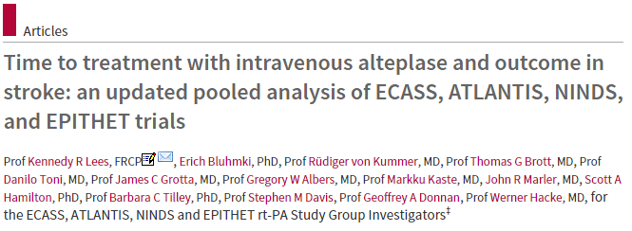
IPD M-A – 2010
8 trials included with 3,670 patients
NINDS 1+2 and ECASS III were only trials finding significant improvement in functional outcome
5 trials (ECASS, ECASS II, ATLANTIS A + B, EPITHET) found no improvement in functional outcome
Notes:
An analysis was done in 2010 with most trials not finding benefit, and the trials finding benefit having some baseline difference concerns, yet the overall analysis reported significant benefit.

Slide 25
IPD M-A – 2010
SUBGROUP of patients treated 3-4.5 hours after stroke
N = 1,620 patients
mRS 0-1 at 90 days in 44.6% vs. 37.7% (NNT 15)
clinically relevant hemorrhage in 4.3% vs. 1.2% (NNH 33)
Notes:
The subgroup analysis for 3-4.5 hours (in which ECASS III was the only data to support benefit and it could be questioned regarding baseline differences) still reported a significant benefit for thrombolytics.

Slide 26
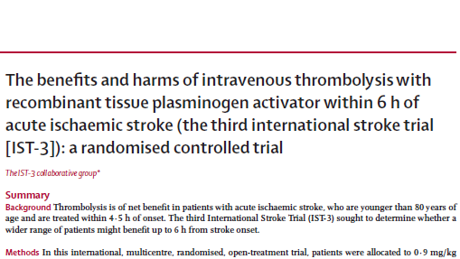
IST-3 trial– 2012
3,035 patients total
0-6 hours
primary outcome: OHS 0-2 at 6 months in 37% vs. 35% (not significant)
“An ordinal analysis showed a significant shift in OHS score (p = 0.001)”
death at 7 days in 11% vs. 7% (NNH 25)
Notes:
So we may still think there is overall benefit in 2010 based on the meta-analysis. In 2012 the largest trial to date is published – IST-3 with > 3,000 patients. The trial was not blinded (no placebo control) and included patients not already “established” to benefit from thrombolytics by local guidelines, so in actuality the groups at 0-3 hours, 3-4.5 hours, and 4.5-6 hours are not similar and this may be more properly considered as 3 different trials. Anyway there was no difference in the primary outcome so no overall benefit suggested but a secondary outcome was reported with a statistically significant finding suggesting benefit and there was a 4% absolute increase in mortality at 7 days. The authors concluded “despite the early hazards, thrombolysis within 6 hours improves functional outcome”

Slide 27
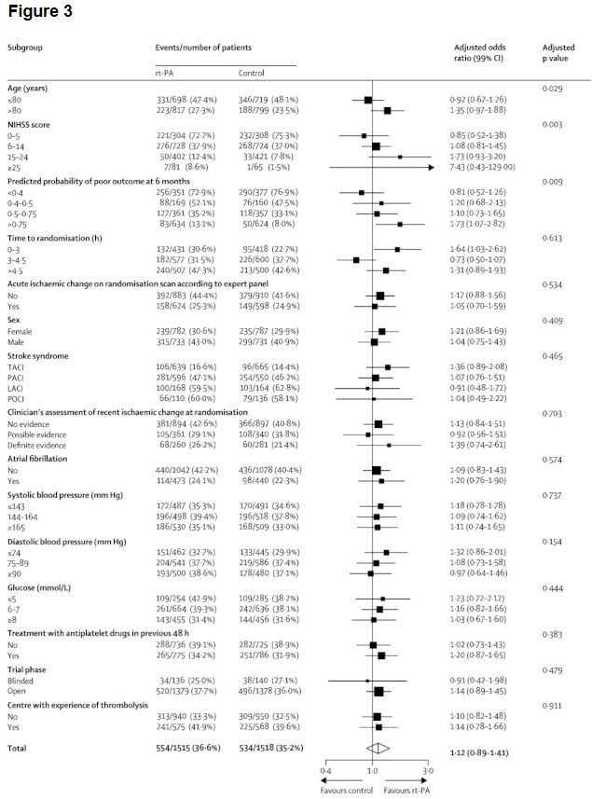
IST-3 trial– 2012
SUBGROUP of patients 3-4.5 hours after stroke
1,177 patients
OHS 0-2 at 6 months in 31.5% vs. 37.7% (NNH 16)
Notes:
Looking at the subgroup of patients treated 3-4.5 hours after stroke in IST-3 the functional outcome (alive and independent at 6 months) was LESS LIKELY with thrombolytics. This substantial signal of harm was ignored as it did not appear statistically significant.

Slide 28
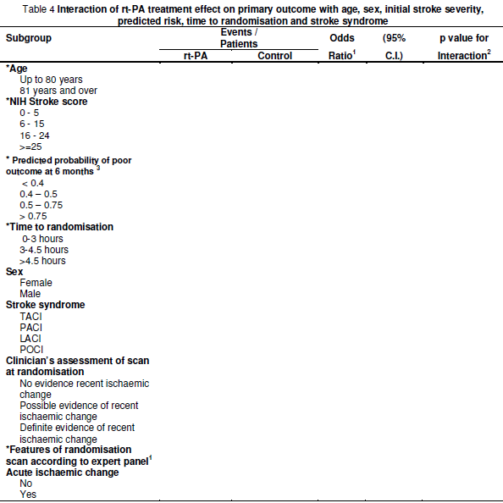
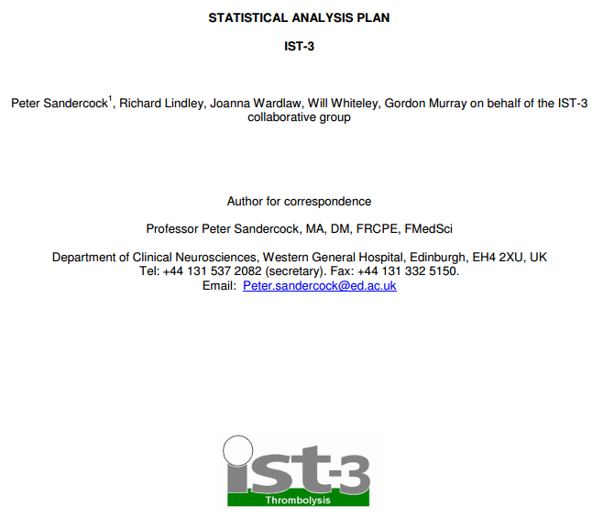
IST-3 trial– 2012
Notes:
But it did not appear statistically significant by using a 99% confidence interval. The protocol for IST-3 specified no adjustments for multiple testing would be made and results would be reported using 95% confidence intervals. But it was reported with 99% confidence intervals, making a statistically significant finding appear non-significant.

Slide 29
IPD M-A - 2010
IST-3 - 2012
1,620 patients
3-4.5 hours after stroke
mRS 0-1 at 90 days in 44.6% vs. 37.7% (NNT 15)
1,177 patients
3-4.5 hours after stroke
OHS 0-2 at 6 months in 31.5% vs. 37.7% (NNH 16)
Notes:
So now with a 2010 meta-analysis finding a benefit in functional outcome (NNT 15, assuming you believe that data) and a new trial finding a harm in terms of the functional outcome (NNH 16) what is the overall result for using throbmolytics 3-4.5 hours after stroke?

Slide 30
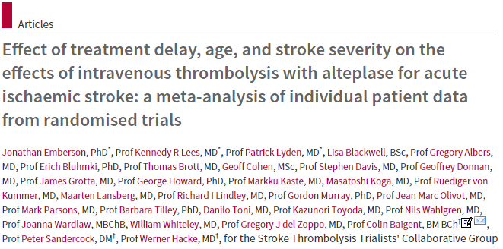
Lancet IPD meta-analysis - 2014
2010 IPD M-A plus IST-3 added
9 trials with 6,756 patients
subgroup at 3-4.5 hours
2,812 patients
mRS 0-1 in 35.3% vs. 30.1%
Notes:
A 2014 meta-analysis combines IST-3 to the 2010 meta-analysis and finds overall benefit, and finds benefit in the subgroup treated at 3-4.5 hours.

Slide 31
IPD M-A - 2010
Ist-3 - 2012
1,620 patients
3-4.5 hours after stroke
mRS 0-1 at 90 days in 44.6% vs. 37.7% (NNT 15)
1,177 patients
3-4.5 hours after stroke
OHS 0-2 at 6 months in 31.5% vs. 37.7% (NNH 16)
IPD M-A - 2014
2010 IPD M-A plus IST-3 added
2,812 patients
3-4.5 hours after stroke
mRS 0-1 in 35.3% vs. 30.1%
Notes:
There are many differences in the data elements considered in the 2010 meta-analysis and the IST-3 trial, but it seems implausible that combining them for the 3-4.5 hours subgroup would still lead to an overall result in 2014 that was not only beneficial, but statistically significant as reported.

Slide 32
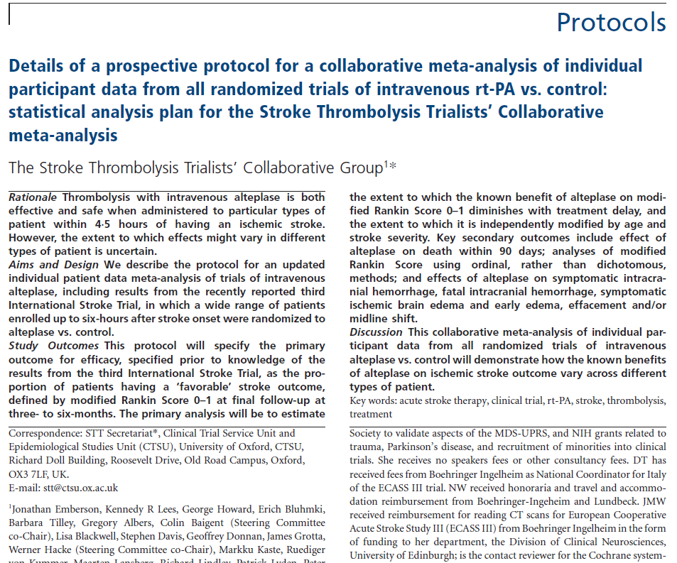
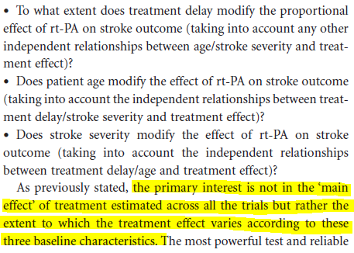
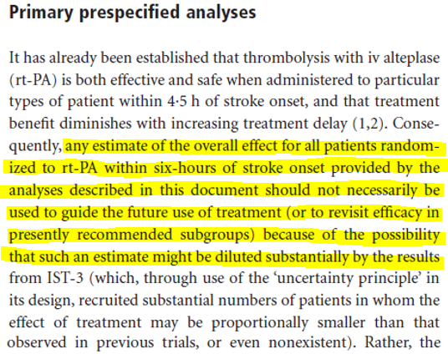
Lancet IPD
meta-analysis
- 2014
Notes:
Evaluation of the protocol for the 2014 individual patient data meta-analysis finds a prespecified approach designed to avoid the possibility that the IST-3 trial data might “dilute substantially” the results of the prior meta-analysis. So what does this mean for how the data was combined and analyzed? And what is the purpose of the 2014 meta-analysis? If not designed to tell us about the efficacy in subgroups of patients or in the overall effect, then what is the purpose of the meta-analysis and what should we do with the results?

Slide 33
Lancet IPD meta-analysis - 2014
Let’s see what this looks like if we view the results from each trial and how they contribute to the overall meta-analysis.
Notes:
If we could see how each trial contributes to the results, and the quality of each trial, then we could understand if the data is consistent or inconsistent and this would help us know how reliable any results may be.

Slide 34
Lancet IPD meta-analysis - 2014
This page intentionally left blank.
Notes:
But this data is not available.

Slide 35
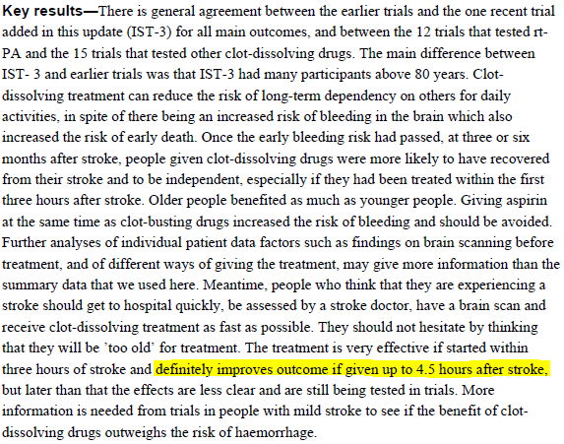
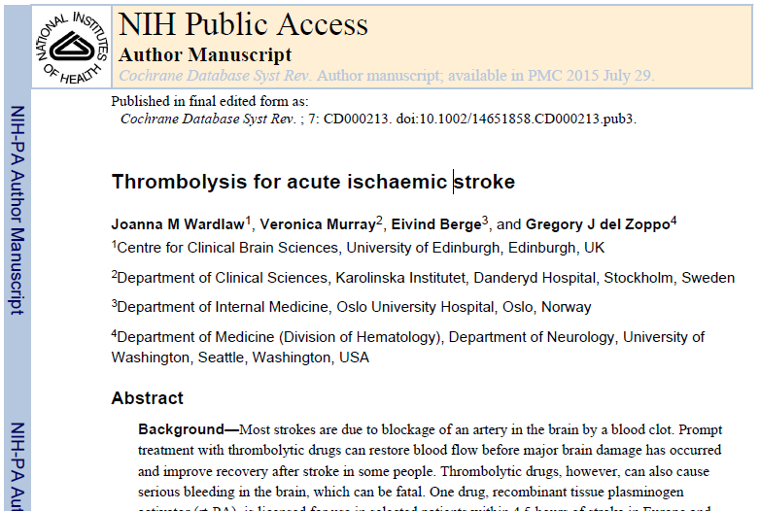
Cochrane review - 2014
27 randomized trials with 10,187 patients
IV t-PA in 12 trials with 7,012 patients
Notes:
A Cochrane review in 2014 looked at thrombolytics for acute stroke and also concludes it improves outcomes up to 4.5 hours after stroke.

Slide 36
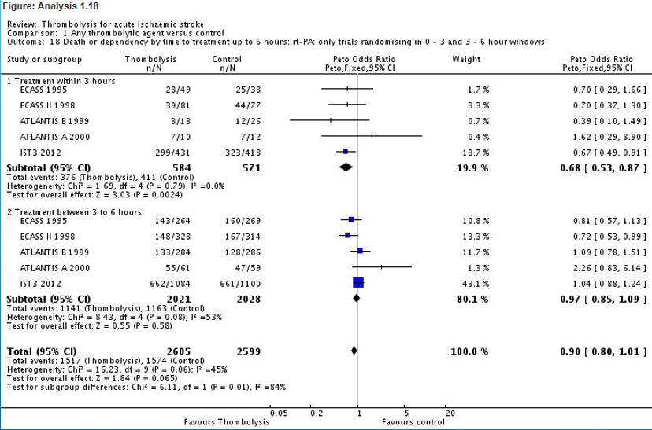
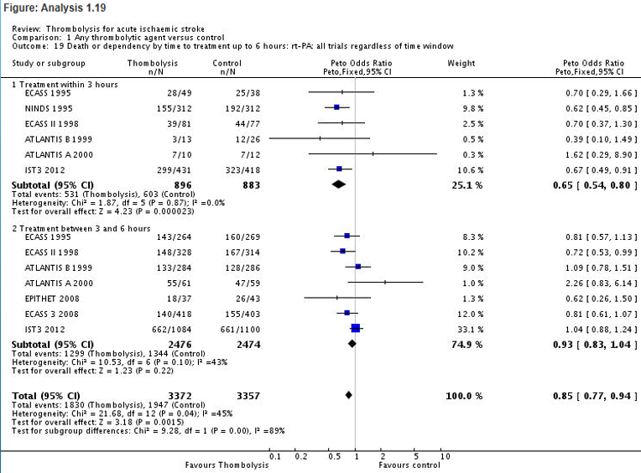
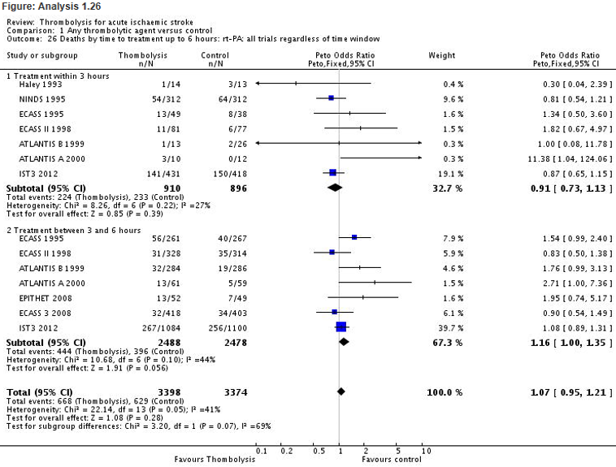
Cochrane review -2014
Notes:
But the data in the Cochrane review does not substantiate the conclusion. The conclusion was derived by referring to the individual patient data meta-analysis. The analyses reported in the Cochrane review consistently show improvements in functional outcome without a significant increase in death when looking at thrombolytics use < 3 hours after stroke, AND CONSISTENTLY SHOW no significant difference in functional outcome and an increase in death for use of thromboltyics 3-6 hours after stroke. The 4.5 hour cutoff was not directly covered with analyses in the Cochrane review.

Slide 37
Evidence biased synthesis
Evidence production
Evidence based synthesis
guidelines
Clinical Practice
Evidence production
guidelines
Clinical Practice
Notes:
So bias in the original trial reporting and synthesis of this data can have profound effects on guideline recommendations and clinical practice.

Slide 38
Statistical Presentation Influencing Neurology
BIAS = systematic error = deviation of results or inferences from the truth, or processes leading to such deviation
When your interpretation is skewed we call it BIAS.
When your presentation is skewed we call it SPIN.
Notes:
When we interpret in ways that deviate from the truth that is BIAS. When we present in ways that deviate from the truth that is SPIN.

Slide 39
Spinning: Good for exercise, not good for communication.

Slide 40
Questions?
Brian S. Alper, MD, MSPH, FAAFP
balper@ebsco.com

